Slide 1

Sentiment Analysis of Amazon Fine Food Reviews
By Priya Nandan Shrotri
989454108

Slide 2


Primary Goal
This project aims to perform sentiment analysis on the customer reviews of Fine Foods from the Amazon marketplace. The main goal is to understand the ratio of positive to negative reviews and help the business make informed market decisions.

Slide 3
Challenges Faced
The volume of Amazon customer reviews across multiple product categories makes it challenging to ensure data consistency and accuracy.
Unstructured textual data, with variations in language, tone, and grammar, complicates achieving accurate sentiment classification.
The subjective nature of customer reviews introduces challenges in maintaining unbiased sentiment labeling.

Slide 4
Project Approach
Data Extraction: Collecting customer reviews from the Amazon Fine Foods dataset for analysis.
Data Preprocessing: Cleaning the data by handling missing values, removing noise (e.g., punctuation and stop words), and normalizing text for consistent processing.
Sentiment Analysis with VADER: Utilizing the VADER library in Python to analyze customer reviews and assign sentiment scores based on textual data.
Linear Regression Analysis: Implementing a linear regression model to compare the actual review scores with the sentiment scores generated from the text, assessing the model's predictive accuracy.

Slide 5
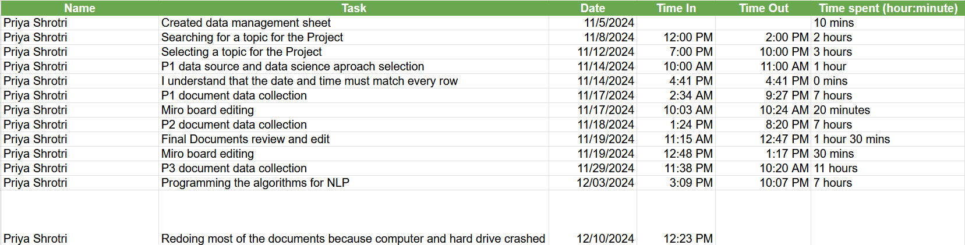
Project Timeline

Slide 6
Challenges Faced
Understanding VADER: Initially, it was challenging to grasp the intricacies of the VADER library and how to apply it effectively for sentiment analysis, requiring significant trial and error.
Linear Regression Implementation: Figuring out the proper implementation of linear regression, including feature selection and model training, was a learning curve that took time and effort to master.
Data Loss: At the final stages of the project, a computer crash resulted in the loss of all data, which led to a stressful recovery process and additional time spent reworking the analysis.

Slide 7
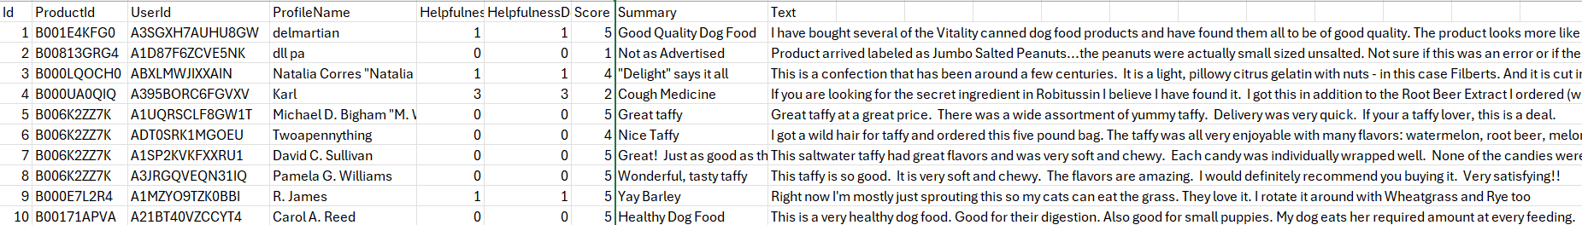
Data Source
The dataset comprises approximately 500,000 Amazon customer reviews on fine food products. It includes information such as helpfulness ratings, review scores (1 to 5), summaries, and full reviews. The important columns are Score and Text.

Slide 8
Key Concepts – VADER Library
Overview: VADER (Valence Aware Dictionary and sEntiment Reasoner) is a Python library used for sentiment analysis.
Specialization: It is designed to analyze text, particularly social media content, for sentiment by evaluating the positivity, negativity, or neutrality of the text.
Key Features: VADER combines a lexicon-based approach with rule-based sentiment intensity scoring.
Advantages: It is simple to use, performs well on short text, and provides normalized scores for better comparability.

Slide 9
Key Concepts – Linear Regression
Overview: Linear regression is a statistical method used to model the relationship between a dependent variable and one or more independent variables.
Purpose: It predicts the dependent variable's value based on the linear relationship with the independent variables.
Key Elements: The model includes coefficients that measure the impact of each predictor and an intercept representing the baseline value.
Evaluation: Performance is measured using metrics like Mean Squared Error (MSE) and R-squared to assess accuracy and variability explained.
Applications: Commonly used in forecasting, trend analysis, and establishing relationships between variables.

Slide 10
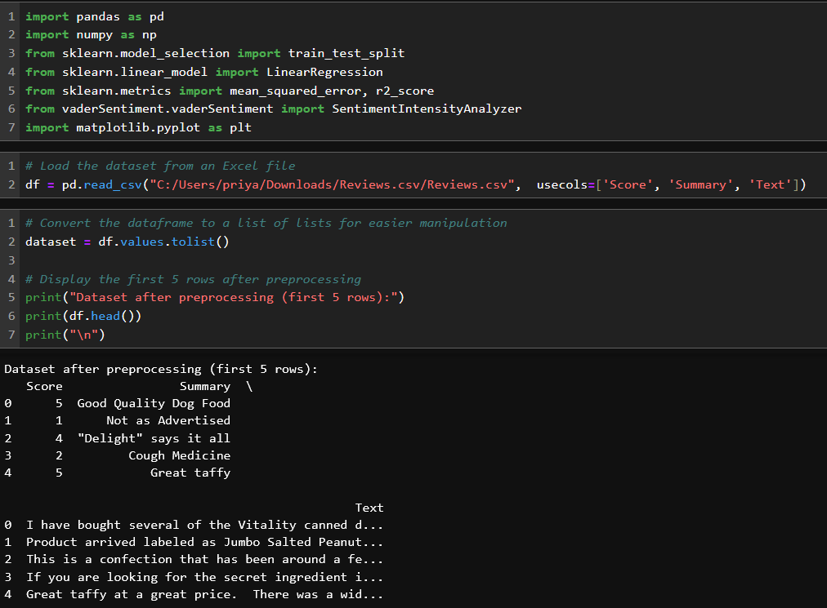
Code explanation – Data Extraction and Preprocessing

Slide 11
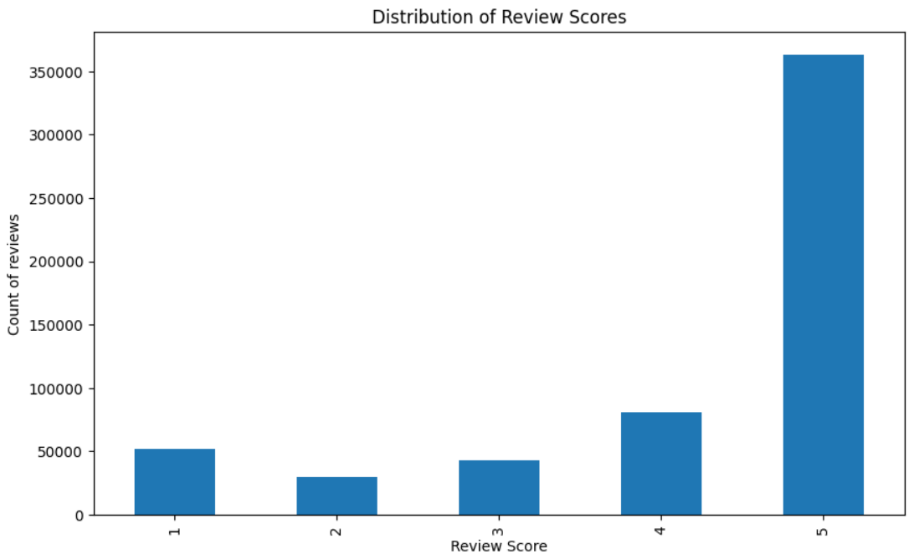
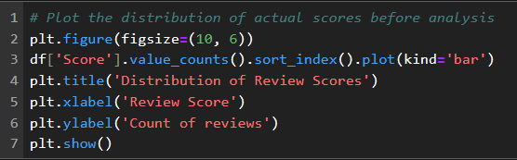
Code Explanation – Plotting Actual Review Scores

Slide 12
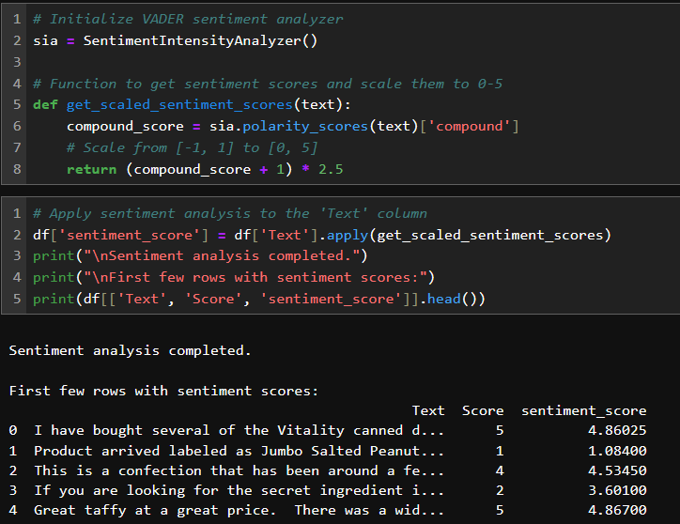
Code Explanation – Sentiment Analysis

Slide 13
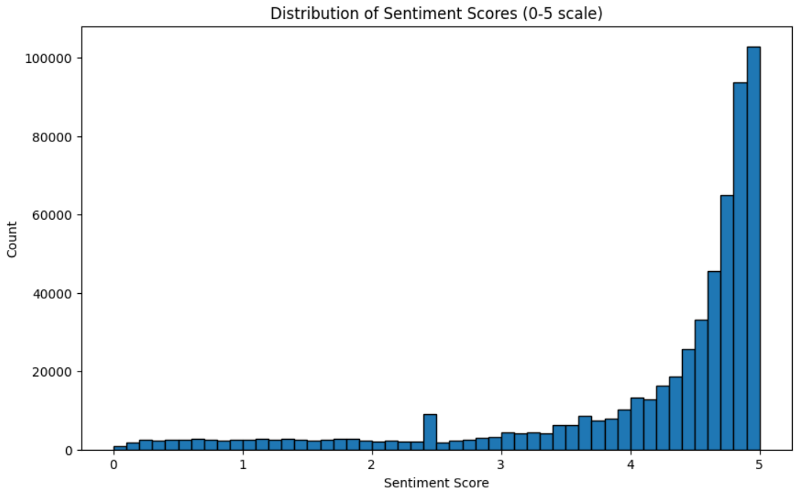
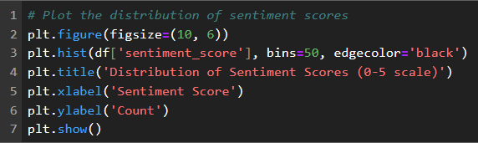
Code Explanation – Plotting New Sentiment Scores Assigned

Slide 14
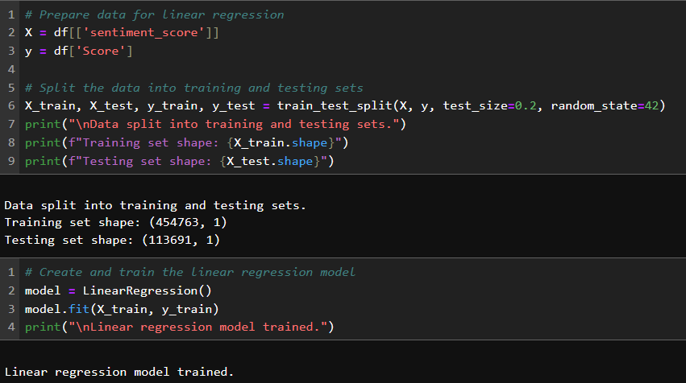
Code Explanation – Linear Regression Model Creation and Training

Slide 15
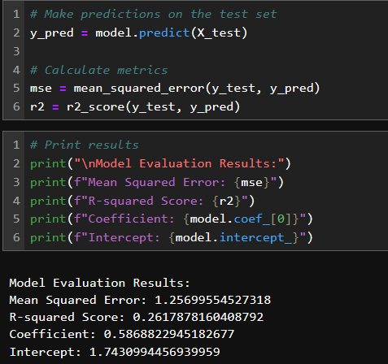
Code Explanation – Testing the Model

Slide 16
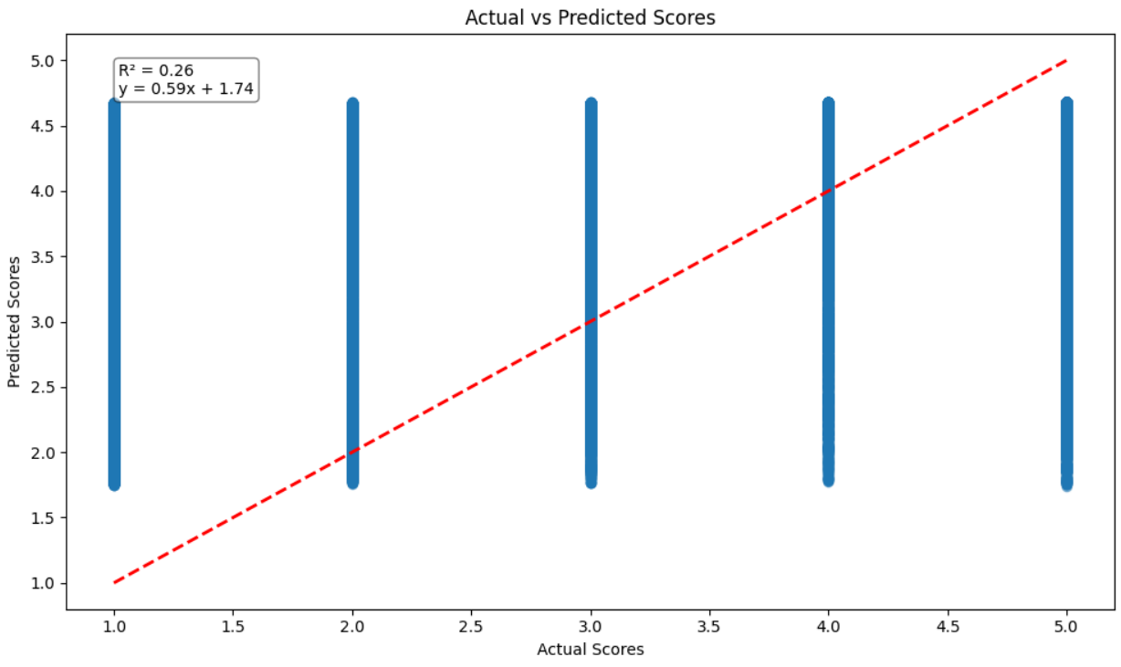
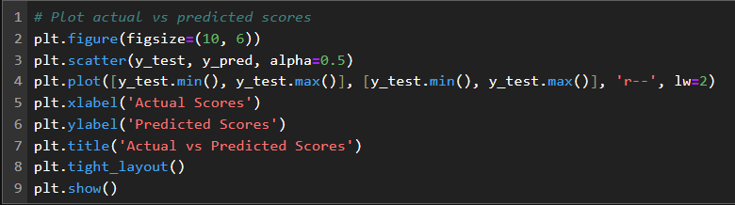
Code explanation – Plotting the Regression Model

Slide 17
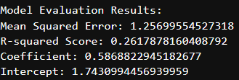
Code Results – Linear Regression Results
The linear regression model produced a Mean Squared Error (MSE) of 1.26, indicating the average squared difference between predicted and actual review scores. An R-squared score of 0.26 shows that 26% of the variability in the review scores is explained by the sentiment analysis model. The coefficient (0.59) suggests that for each unit increase in the sentiment score, the review score increases by 0.59 on average, while the intercept (1.74) represents the baseline review score when the sentiment score is zero.

Slide 18
Key Takeaways
Model Accuracy: The linear regression model achieved an R-squared score of 0.26, explaining 26% of the variance in review scores, and a Mean Squared Error (MSE) of 1.26.
Sentiment Prediction: Sentiment analysis using VADER provides an effective means of predicting sentiment from customer reviews, assigning scores that correlate with actual review ratings.
Sentiment Analysis: VADER successfully identifies positive, negative, and neutral sentiments in fine food reviews, offering valuable insights into customer opinions.
Model Limitations: While the model explains some variability, there is room for improvement in predicting actual review scores more accurately.
Further Developments: Enhancing the model with more advanced techniques (e.g., deep learning or additional features) could improve predictive accuracy and provide deeper insights into customer sentiment.
Business Impact: The findings can guide business decisions by helping identify key factors influencing customer satisfaction and dissatisfaction.

Slide 19
Future Prospects
Enhanced Sentiment Analysis: Incorporating advanced natural language processing (NLP) techniques, such as deep learning models (e.g., BERT or GPT), could improve sentiment classification accuracy and handle more complex expressions.
Predictive Modeling: Expanding the model to predict review scores more accurately based on additional features (e.g., user demographics, product categories) could offer more granular insights.
Multilingual Analysis: Extending sentiment analysis capabilities to multiple languages would allow businesses to analyze reviews across different regions, enabling global market insights.
Automated Customer Insights: Using sentiment data to automatically generate reports or alerts for product managers, helping them identify emerging trends or issues faster.

Slide 20

Conclusion
In conclusion, this project demonstrates the power of sentiment analysis and linear regression in understanding customer feedback. By leveraging VADER for sentiment classification and linear regression for model validation, we can gain valuable insights into customer sentiments and their relationship with product reviews. Future advancements in model accuracy and real-time analysis can further enhance decision-making, providing businesses with the tools to stay ahead of market trends.

Slide 21

References
Liu, B. (2012). Sentiment analysis and opinion mining. Morgan & Claypool Publishers.
Hutto, C. J., & Gilbert, E. E. (2014). VADER: A parsimonious rule-based model for sentiment analysis of social media text. In Proceedings of the Eighth International Conference on Weblogs and Social Media, ICWSM 2014 (pp. 216-225).
Montgomery, D. C., Peck, E. A., & Vining, G. G. (2012). Introduction to linear regression analysis (5th ed.). Wiley.
Choudhury, P., & Kaur, H. (2020). Role of sentiment analysis in business decision making: A review. Journal of Business Research, 112, 1-10. https://doi.org/10.1016/j.jbusres.2019.10.018
Provost, F., & Fawcett, T. (2013). Data science for business: What you need to know about data mining and data-analytic thinking. O'Reilly Media.
Jha, S., & Kumar, A. (2019). Sentiment analysis of product reviews: A case study on Amazon Fine Food Reviews. International Journal of Computer Applications, 178(16), 1-8. https://doi.org/10.5120/ijca2019918797

